Slide 1



NLP for Research in Pharma Industry
Anish Mahapatra | 7 January, 2022

Slide 2

Agenda
01
Introduction
02
The Data Lifecycle
03
Understanding Proof of Concept (PoC) versus Production for NLP
04
NLP for Research Architecture
05
The Data Science Process Flow
06
Key Takeaways

Slide 3
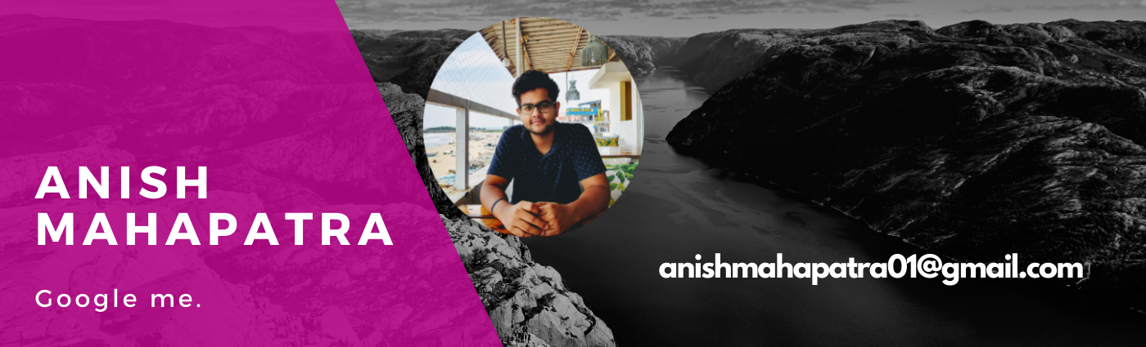










Topic 1 of 6
Introduction
Senior Data Scientist
LinkedIn: www.linkedin.com/in/anishmahapatra Medium: anishmahapatra.medium.com Website: www.anishmahapatra.com
GitHub: www.github.com/anishmahapatra
Q. How to get into Data Science?
A. Simple, ask a real-world Data Scientist.

Slide 4
Topic 2 of 6
The Data Lifecycle
01
02
03
Data Access
Data Silos to Data Warehouse
Data Analytics & Modelling
Identify List of Data Owners,
Request Access,
Maintain Single POC,
Understand current process
Exploratory Data Analysis,
Business Analytics,
Heuristic, Statistical & ML Models.
Experimentation
Make Data Dictionary, Make ER Diagram, Form Analytical Data frame
06
05
04
Business Decisions, Impact Analysis
Data Visualization & Dashboarding
Feature Engineering
Building new features, Combining external data, Building a feature store
Model Evaluation, Monitoring Model Performance and Drift, Data Governance Policies
Dashboards to aid decision-making,
Decide concurrency, cadence and security

Slide 5
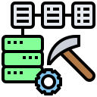
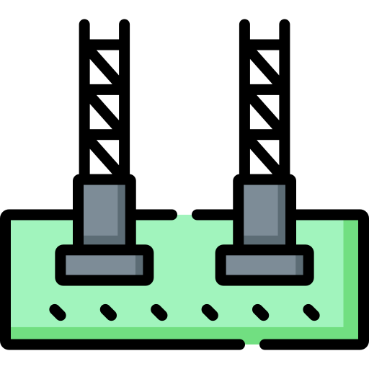
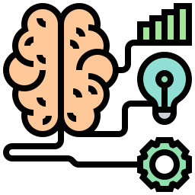

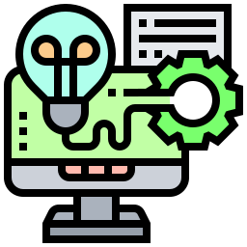

Topic 3 of 6
PoC versus Production
Proof of Concept
Production
01
01
Idea
Strong Foundation
Every great project starts with an idea. Project idea, funding, team composition
Production projects generally start off with proof that it is worth scaling
02
02
Experiment
Scale & Test
Quick and effective experiments can help prove/disprove hypotheses
Multiple components such as concurrency, infrastructure, integration have to be tested as projects scale
03
03
Iterate
Maintain & Improve
Building and understanding multiple ways to tackle a problem are the core of a good proof of concept
Large projects require maintenance and improvements based on feedback

Slide 6





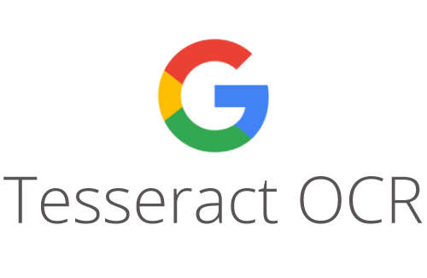
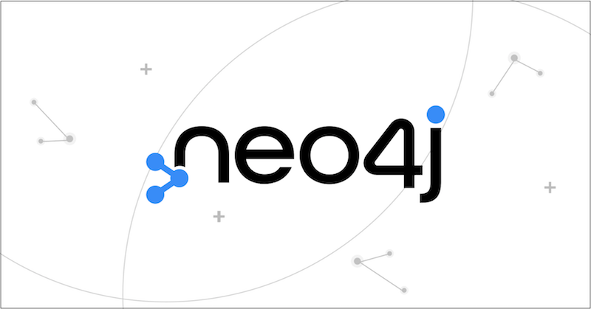



Topic 4 of 6
NLP for Research Architecture
Backend
Analytics
Frontend
04
Chatbot
02
Graph
Database
01
Cloud
OCR
03
06
Website
05
Search
PDF documents stored in cloud
Optical Character Recognition done to convert pdf to readable text
Documents broken down to sections and fed into a graph database
Search results from Chatbot / Traditional Search showcased on a website
Notes:
Source: https://databricks.com/blog/2020/08/20/modern-industrial-iot-analytics-on-azure-part-3.html

Slide 7
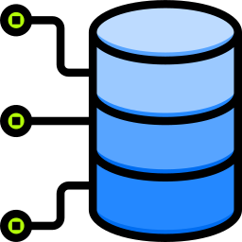

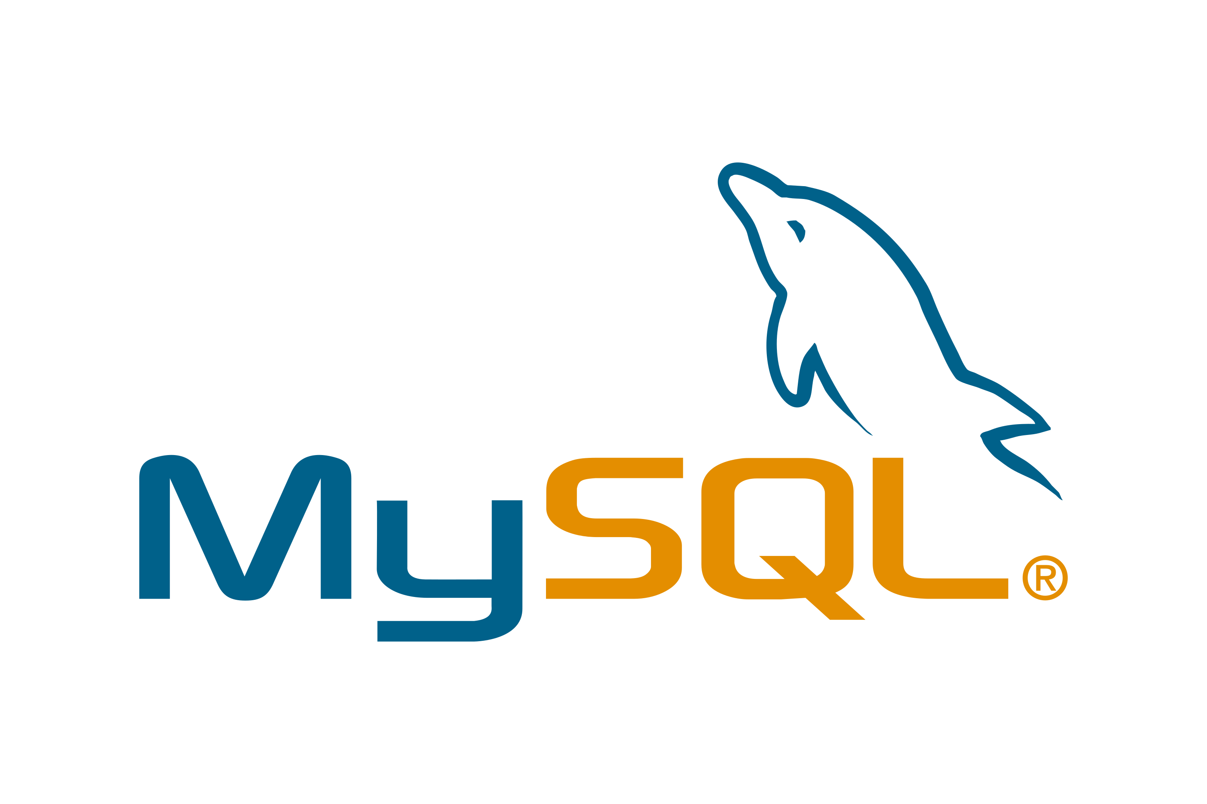
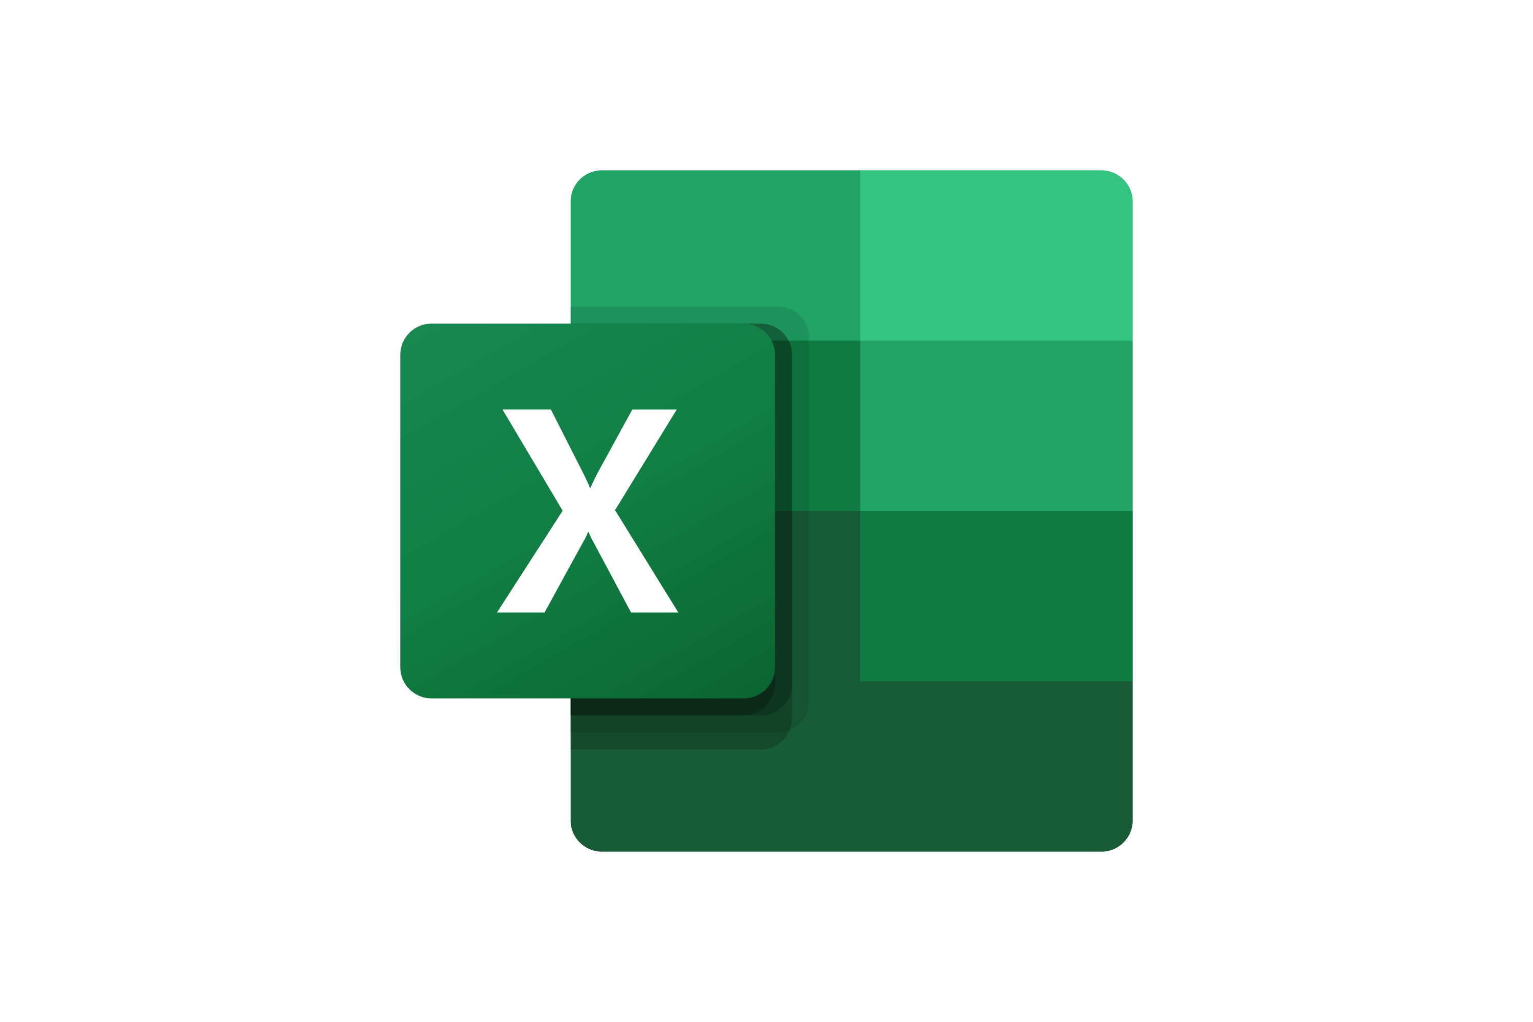
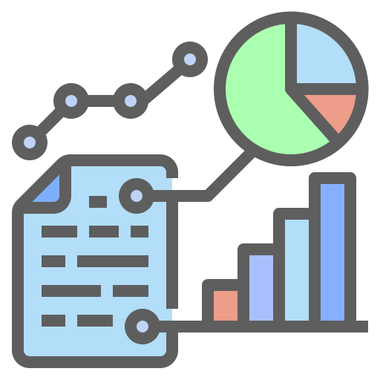


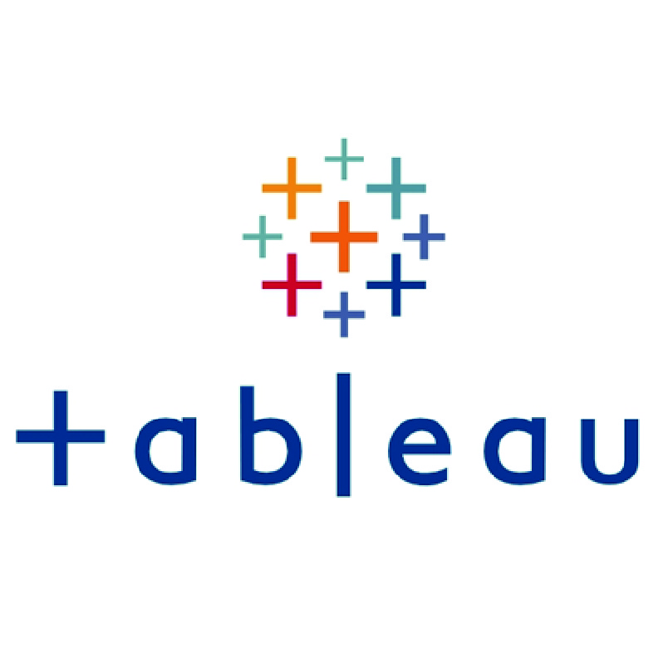



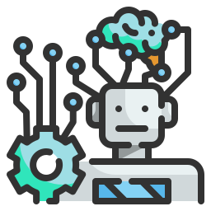



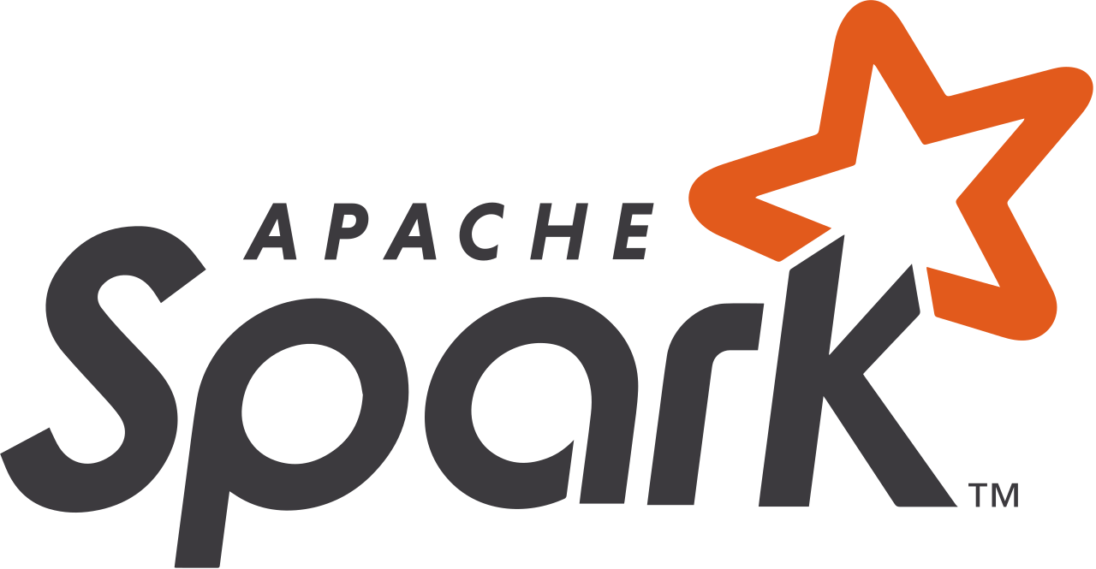


Topic 5 of 6
The Data Science Process Flow
1 Get Data from Data Silos
6 Impact Analysis
Bring data from data silos to data warehouses (ETL)
Data Science is experimental. Fail fast and build faster to maximize profit
2 Understand what the business does
5 Present to the
Business Stakeholders
The business already does things a certain way. First, match the business to show business impact
Analytics is only helpful to the business if it helps them make money. Data Science is Business, Mathematics & Technology.
3 Data Engineering
4 Machine Learning
Orchestrate and build pipelines to automate the process
Models are of three main types: Heuristics-based, Statistical or AI/ML

Slide 8
Topic 6 of 6
Key Takeaways
01
What happens to Data in Data Science
02
Working of PoC and Production Projects
03
The architecture for NLP
04
The Data Science Process Flow

Slide 9

Career Road Map in Data Science
Anish Mahapatra
Q&A Session
LinkedIn: www.linkedin.com/in/anishmahapatra
Email: anishmahapatra01@gmail.com

Slide 10

NLP for Research in Pharma Industry
Anish Mahapatra | 4 January 2022
Q. How to get into Data Science?
A. Simple, ask a real-world Data Scientist.
Email: anishmahapatra01@gmail.com
Thank you.

